Slide 1

Data hiding tool
GROUP 25

Slide 2

About the Project....

Slide 3


Problem statement/Objective
Problem — There are many tools available online which uses cryptography and steganography separately but there is hardly any open-source tool which uses a combination of both of these .
So, our objective is to create a tool that does not only encrypts data but conceal it as well. This will enhance the level of security to the user’s data.
As even if someone gathers the data, firstly he will have to identify that something discrete is hidden inside it and even if he does this then he will have to decrypt it as well to get the original confidential data so this whole process will be very difficult to execute, and time taken.

Slide 4

Proposed work
As mentioned earlier, that we will combine Cryptography with Steganography.
The user will be asked to enter the data then after obtaining the data it will be encrypted with AES-256 algorithm after the encryption it will be concealed in an image using image Steganography.
To get the original data firstly user will be authenticated using the unique key. Then the data firstly will be extracted from the image then it will be decrypted.
To make it user friendly we will convert this into a GUI or an online tool.

Slide 5
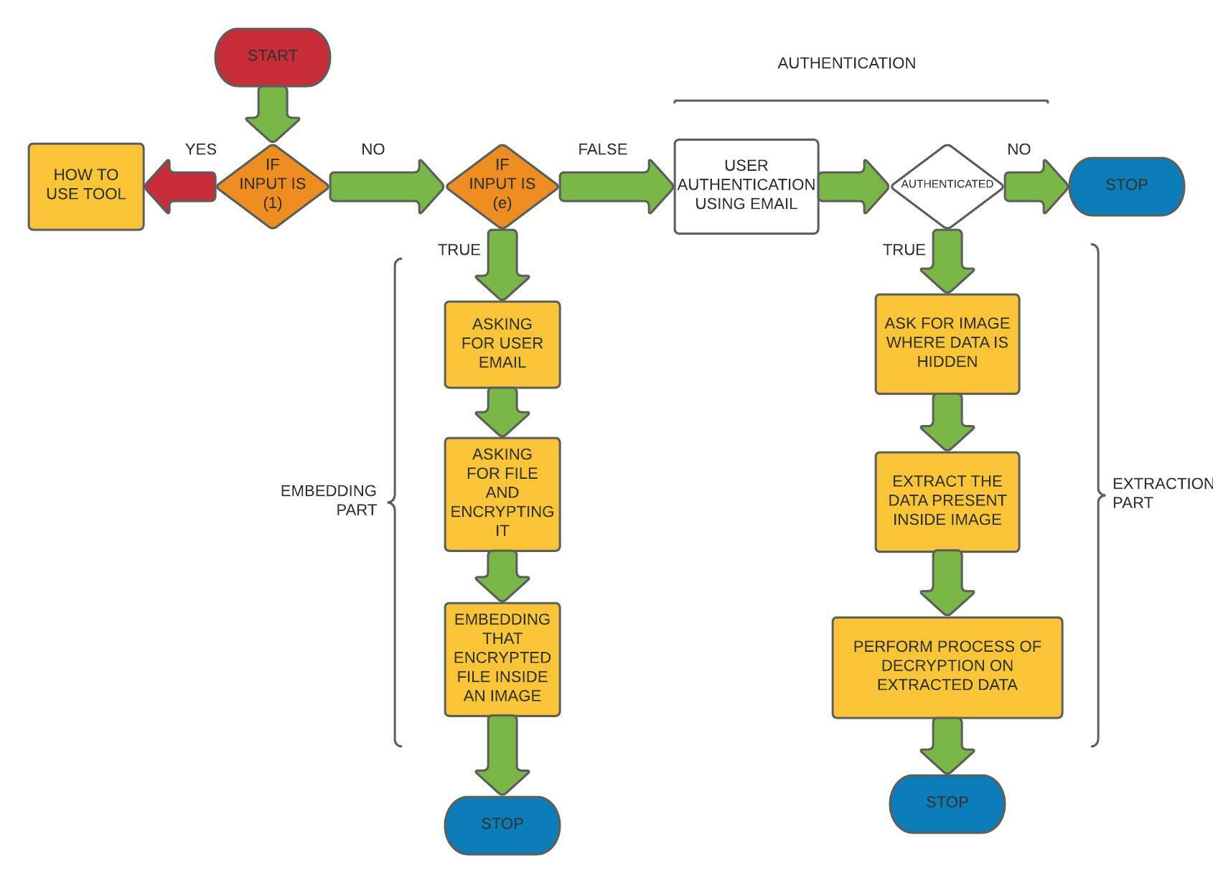
FLOW DIAGRAM

Slide 6


Modules used
MODULES​ | WOKING / EXPLANATION​
cryptography | This module of the cryptography package supports cryptographic functions like encryption and decryption.​
PIL ​ | ​it's used for different format of images.
stegano | ​It’s the python steganography module.
tkinter.filedialog​ | This module provides classes and factory functions for creating file/directory selection windows.​
smtplib,ssl​ | This module is used for sending emails using the Simple Mail Transfer Protocol (SMTP) with or without a secure encrypted protocol to connect to the SMTP server​
tkinter ​ ​ | This framework provides a simple way to create GUI elements using the widgets found in the Tk toolkit.​ ​
pycrypto | Used for AES-256 encryption in python.

Slide 7
Progress Till Now...

Slide 8
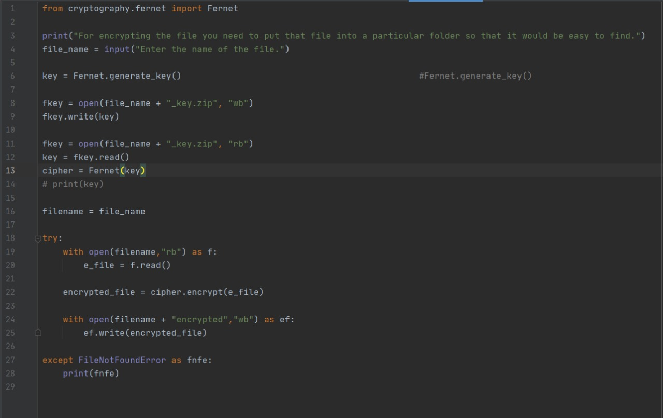
Encryption Code

Slide 9
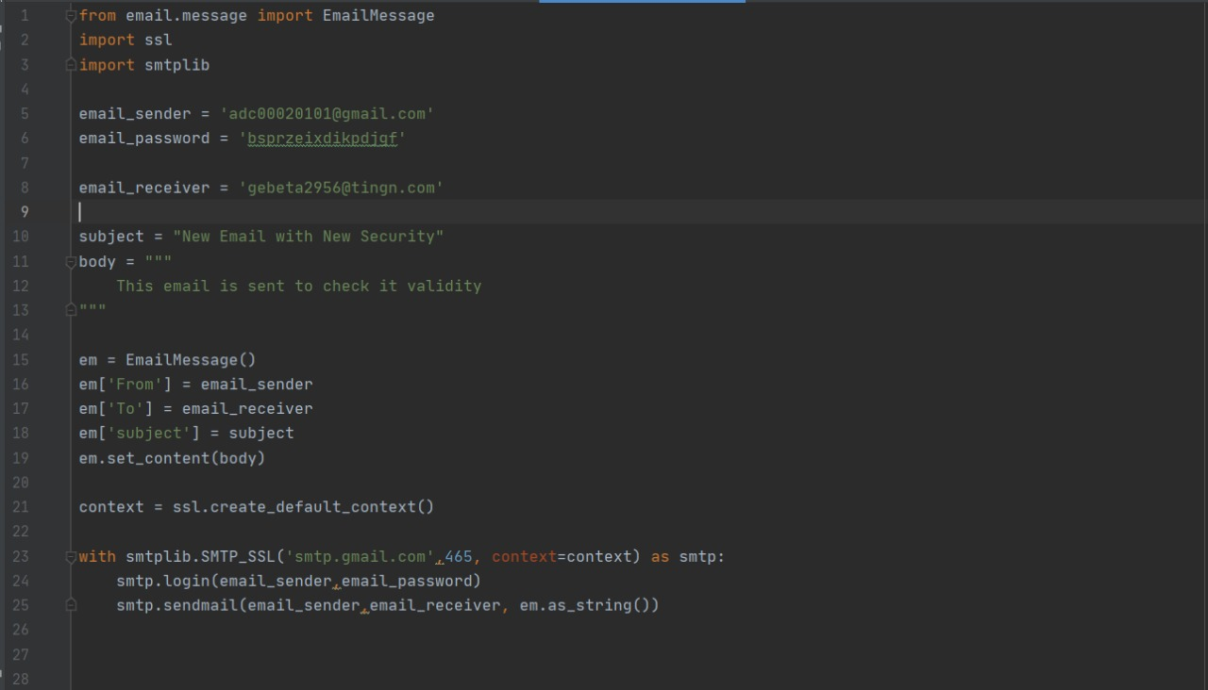
Email Sending code

Slide 10
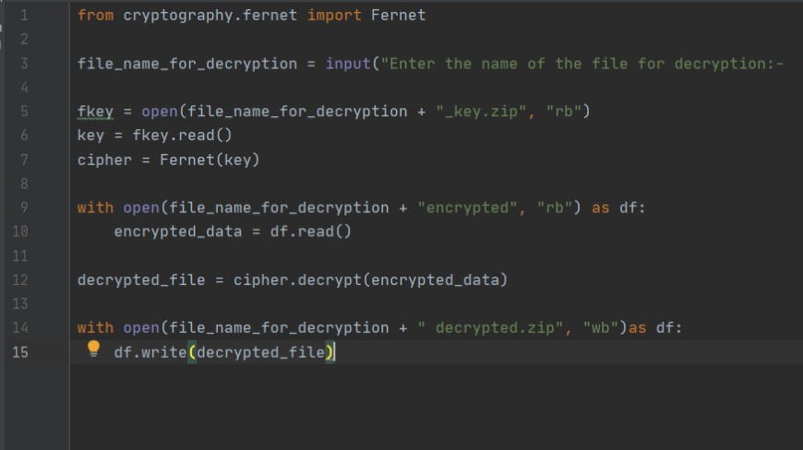
Decryption Code

Slide 11
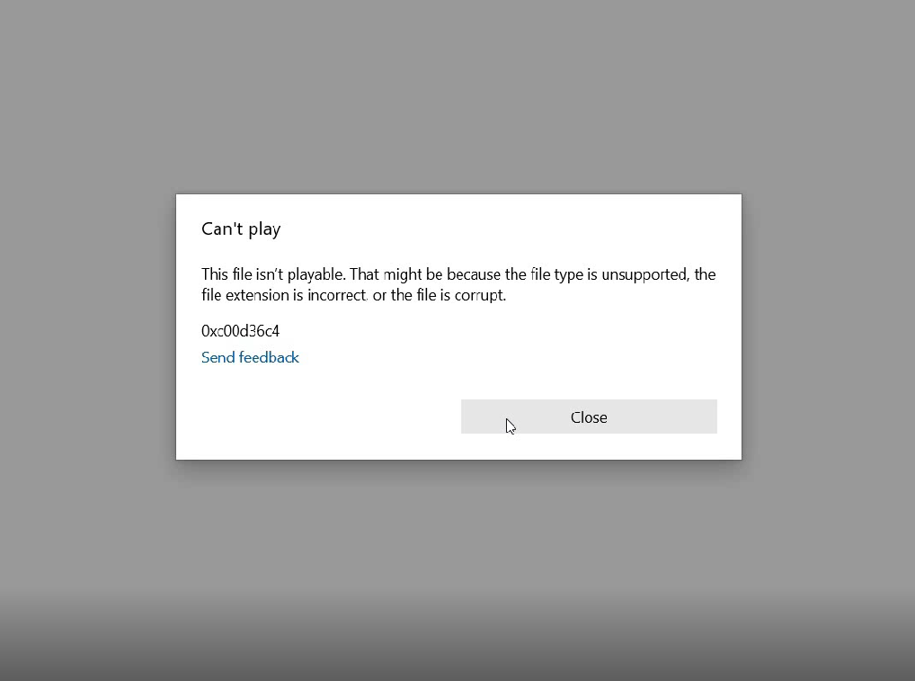
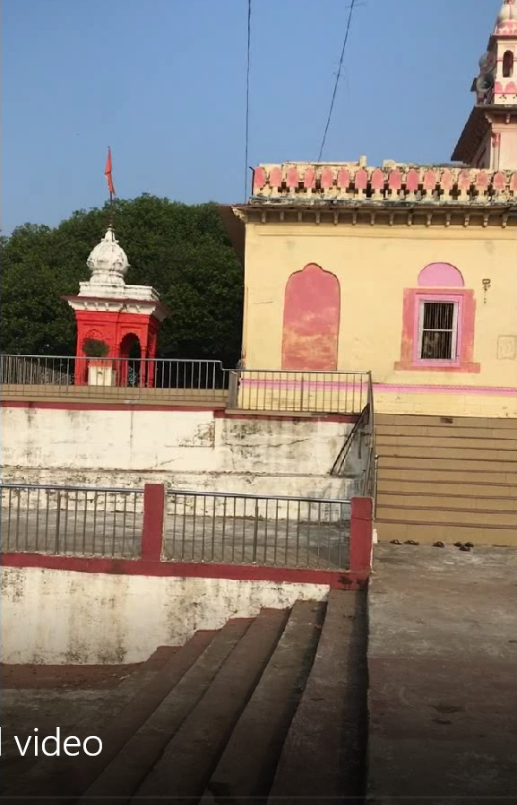
RESULTS & DISCUSSION
AFTER
BEFORE

Slide 12
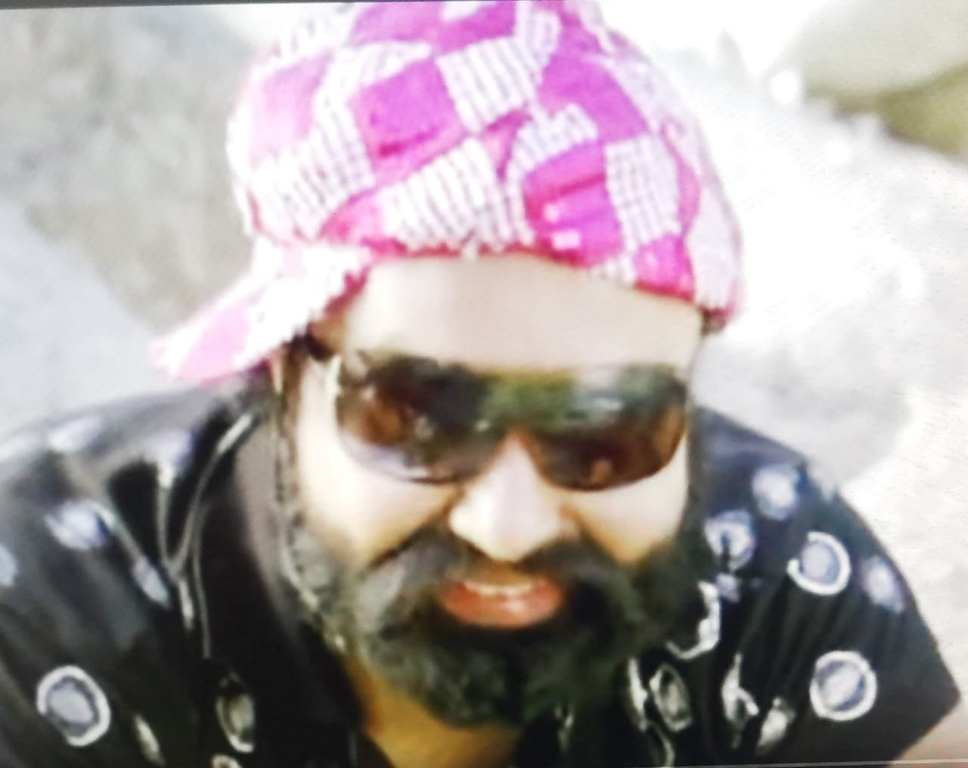
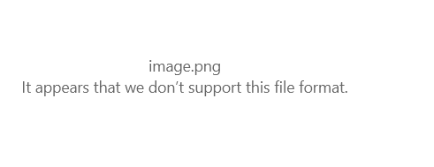
BEFORE
AFTER

Slide 13

Team Members
Yogesh Kumar 19BCY10026
Suryakamal Jain 19BCY10071
Parth Chauhan 19BCY10083
Aditya Chouhan 19BCY10085

Slide 14

Thank You

